Slide 1
Redux
Yurii Martynenko

Slide 2
Agenda
What is Redux ?
Redux Core Concepts
State, Actions, Action Creators
Reducers
Store
Redux Data Flow
Using Redux with React
Redux Middleware
Why Use Redux with React?
Who uses React and Redux?
Resources

Slide 3

What Is Redux?
Created by Dan Abramov for a talk at React Europe 2015 to demonstrate the idea of "time-travel debugging". Now the most widely used state management tool for React apps.
"A predictable state container for JavaScript apps"
"Flux taken to its logical conclusion"
"A platform for developers to build customized state management for their use-cases, while being able to reuse things like the graphical debugger or middleware"

Slide 4
What Is Redux?
Redux attempts to make state mutations predictable by imposing certain restrictions on how and when updates can happen. These restrictions are reflected in the three principles of Redux:
Single source of truth: The state of your whole application is stored as a tree of plain objects and arrays within a single store. (How much you put in the store is up to you - not all data needs to live there.)
State is read-only: State updates are caused by dispatching an action, which is a plain object describing what happened. The rest of the app is not allowed to modify the state tree directly.
Changes are made with pure functions: All state updates are performed by pure functions called reducers, which are (state, action) => newState

Slide 5
Redux Core Concepts

Slide 6
State, Actions, Action Creators
State
App state is stored in plain objects, like this Todo example. There's no "setters", so that different parts of the code can’t change the state arbitrarily. That helps avoid hard-to-reproduce bugs.
Actions
To change something in the state, you need to dispatch an action. An action is a plain JS object with a type field.
Action Creators
It is common to use action creator functions to encapsulate the process of creating action objects. This may seem like overkill for simple use cases, but consistent use of action creators leads to cleaner code and better reusability. Action creators are not required, but are a good practice.

Slide 7
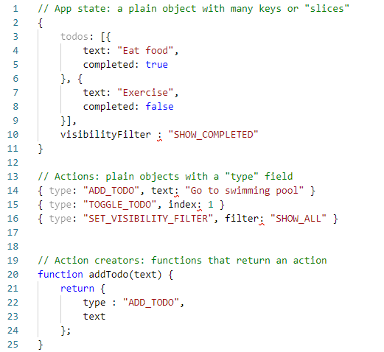

Slide 8
Reducers
Reducers
All state update logic lives in functions called reducers. Since they're just functions, smaller functions can be composed together into larger functions. Because reducer functions are simply (state, action) => newState, they are very easily testable and straightforward to understand.
Reducers should be pure functions, with no side effects. That means they should only rely on inputs, and not affect anything external. Reducers need to update data immutably, by making copies of state and modifying the copies before returning them, rather than directly modifying inputs.

Slide 9
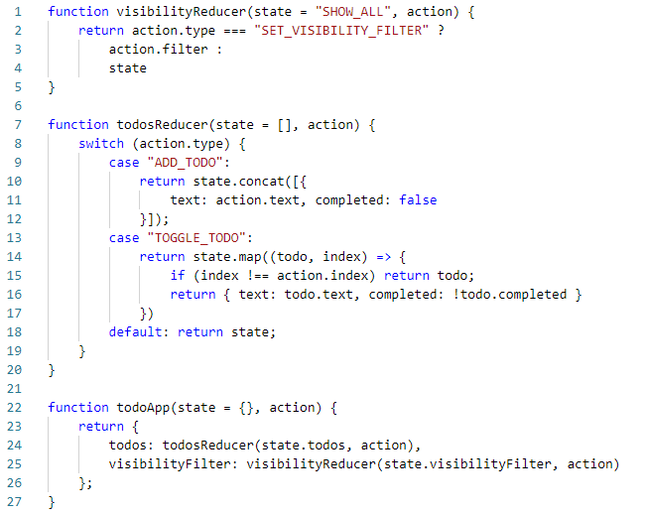

Slide 10
Store
A Redux store contains the current state value. Stores are created using the createStore method, which takes the root reducer function and an optional preloaded state value.
Stores have three main methods:
dispatch: starts a state update with the provided action object
getState: returns the current stored state value
subscribe: accepts a callback function that will be run every time an action is dispatched

Slide 11
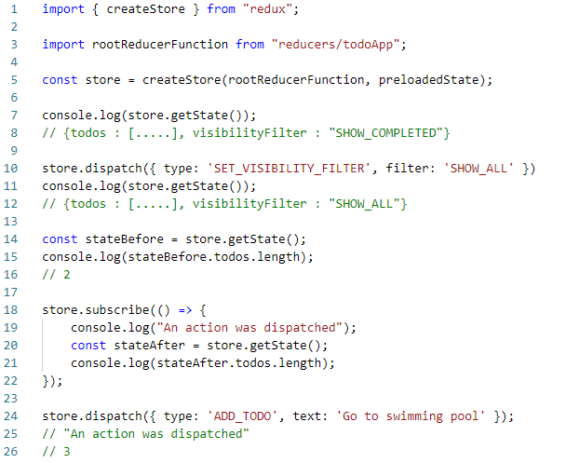

Slide 12
Redux Data Flow
Redux features a uni-directional data flow, as opposed to ideas like "two-way data binding", or approaches where any model can be modified by any code at any time:
An action is dispatched (often in response to
user interaction).
The root reducer function is called with the current state and the dispatched action. That root reducer may delegate the work to other smaller reducer functions. It then returns the new state.
The store notifies subscribers by running their callback functions.
Subscribers (usually UI components) can retrieve the updated state and re-render.

Slide 13
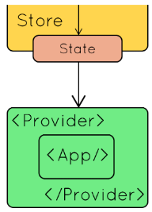
Using Redux with React
Redux can be used with any UI layer (such as Angular, Vue, or plain JS), but is most commonly used with React. The official React-Redux package provides bindings between React and Redux.
The connect function generates wrapper "container" components that subscribe to the store, so you don't have to write store subscription code for every component that needs to talk to the store.
Any component in your application can be wrapped with connect and "connected" to the store. Connecting more components is usually better for performance.
Finally, putting a <Provider> component around your root component makes the store accessible to all connected components.

Slide 14
Using Redux with React
The connect function takes two arguments, both optional:
mapStateToProps: called every time the store state changes. It receives the entire store state, and should return an object full of data. Each field in the returned object becomes a prop for the wrapped component.
mapDispatchToProps: called once on component creation. It receives the dispatch method, and should return an object full of functions that use dispatch.

Slide 15
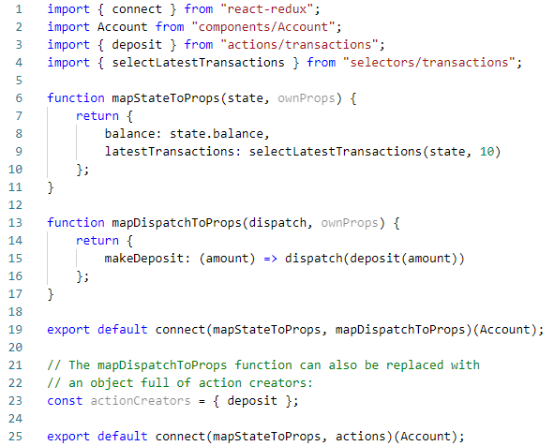

Slide 16
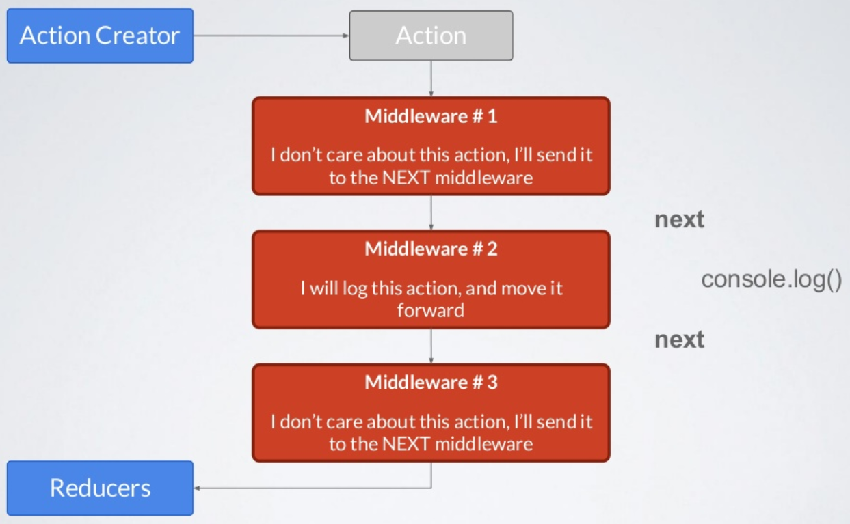
Redux Middleware
A Redux store can be configured to use middleware. Middleware provides the capability to run code after an action is dispatched, but before it reaches the reducer. Middlewares form a pipeline that wraps around the dispatch function. Each middleware in the chain can pass actions onward, restart the dispatch pipeline, and access the store state.

Slide 17
Why Use Redux with React?
Since a React component can already store data in its internal state, why would you need to use Redux to manage that data instead? Besides "predictable state updates" and "centralized state handling", here's a few more reasons:
"Time-travel debugging" allows developers to step back and forth in the history of dispatched actions, see the state and UI at each point in time, and even alter the history by canceling actions.

Slide 18
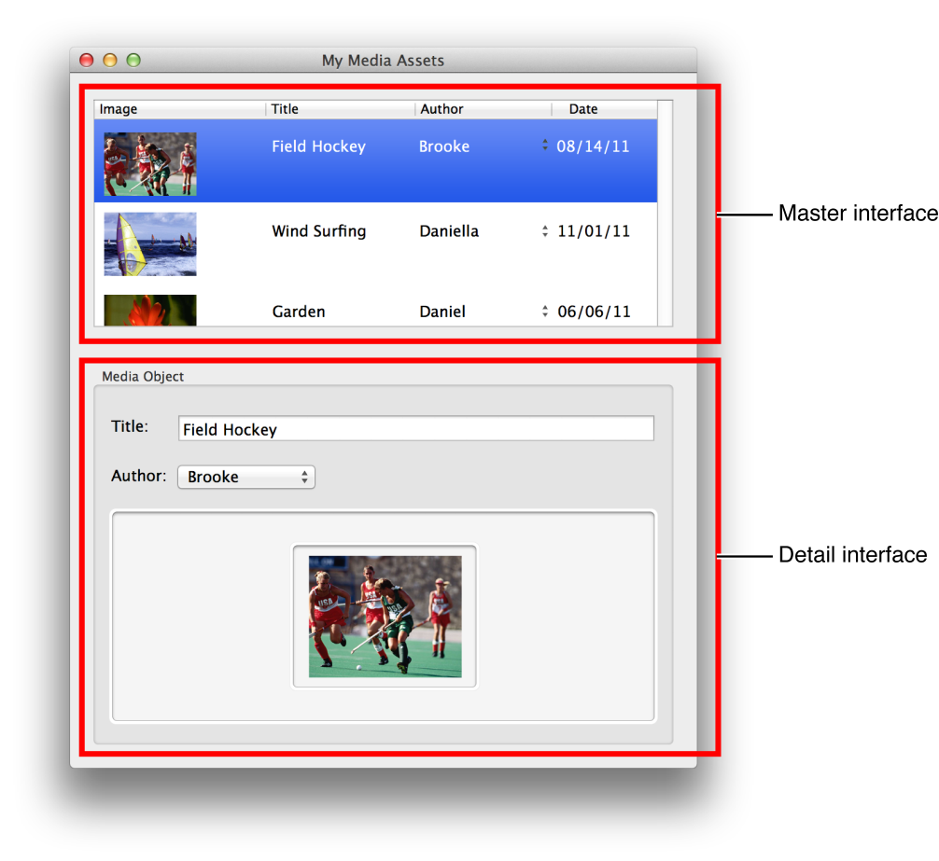
If multiple components need to display the same data in different ways, storing the data outside the component tree makes it easier for each component to retrieve the data it needs, without having to pass it as props all the way down from top-level components.

Slide 19
Modern JS build tools like Webpack have a capability called hot module reloading, which allows replacing pieces of your code as you make edits (without having to refresh the entire page). If React components are swapped, they lose their internal state. Keeping app state in Redux allows you to "live-edit" your components, while keeping all data intact.

Slide 20
Who uses React and Redux?
Twitter (mobile site)
Instagram (mobile app)
JSGram (Desktop and mobile)
Reddit (mobile site)
Wordpress (Calypso admin panel)
Jenkins (BlueOcean control panel)
Mozilla Firefox (DevTools)
Cloud Imperium Games (Spectrum forums/chat)
And many, MANY more!

Slide 21
LINKS / RESOURCES
https://react-redux.js.org/
https://redux.js.org/
https://blog.isquaredsoftware.com/
https://getinstance.info/articles/react/learning-react-redux/
https://www.codingame.com/playgrounds/8894/redux-tutorial-for-beginners

Slide 22
Thank you

